Slide 1
Database Management Systems
Pravin Y Pawar

Slide 2
Traditional file systems for storing the data
Issues
In any business application, information about customers and savings accounts etc. need to be stored
One way to keep the information on computers is to store in files provided by operating systems (OS).
Disadvantages of the above System
Difficulty in accessing data (possible operations need to be hardcoded in programs)
Redundancy leading to inconsistency
Inconsistent changes made by concurrent users
No recovery on crash
The security provided by OS in the form of password is not sufficient
Data Integrity is not maintained

Slide 3
DBMS
Solution to Data Storage and Retrieval issues
Databases and Systems to manage them have become significant components of any present day business of any nature
These databases help businesses to perform their day-to-day activities in an efficient and effective manner
Banking
Travel ticket reservation
Library catalog search
Advances in technology have given raise to new concepts-
Multimedia databases
GIS
Web data
Data warehousing and mining

Slide 4
Data and Databases
Related
Data
Known fact that can be recorded and that has implicit meaning
Example – Students data
ID
Name
Telephone number
Email id
Programme
The data can be stored in a file on a computer
Database
A collection of logically related data
Example – University database
collection of all students data
courses data
faculties data
A database is designed, built and populated with data for a specific purpose

Slide 5
DBMS
Defined
A collection of programs that enables users to create and maintain databases in a convenient and effective manner
DBMS is a software system that facilitates the following:
1.Defining the database
includes defining the structures, data types, constraints, indexes etc.
Like Database catalog/Data dictionary/ called as Meta-data
2.Constructing the database
means storing data into the database structures and storing on some storage medium
3.Manipulating database for various applications
encompasses activities like –
querying the database
inserting new records into the database
updating some data items
deleting certain items from the database

Slide 6
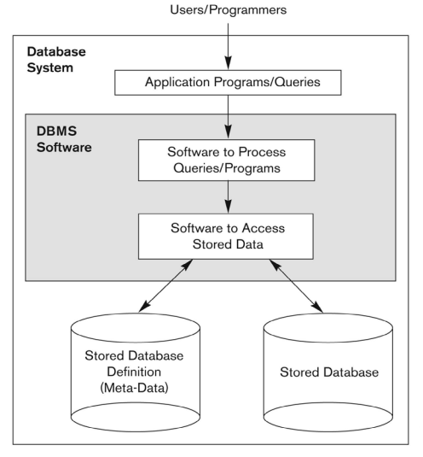
DBMS
A simplified database system environment
Adapted from Fundamentals of Database Systems by Elmasri, Navathe

Slide 7
Thank You!
In our next session:

